Slide 1
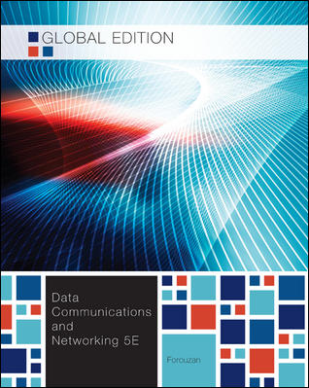
Chapter 14
Other Wired Network
School of Computer Science and Engineering
Pusan National University
Jeong Goo Kim

Slide 2
Ch. 14 Outline
    Outline
14.1 Telephone Network
14.2 Cable Network
14.3 SONET
14.4 ATM

Slide 3
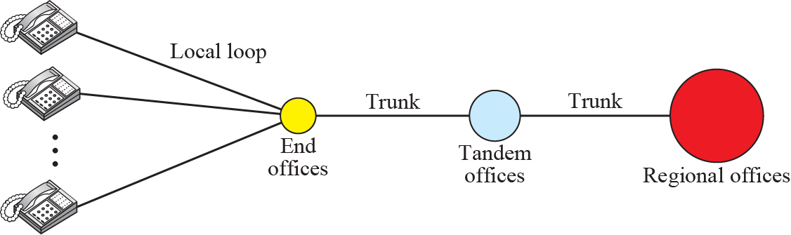
    14.1 Telephone Network
    14.1 Telephone Network
has begun in the late 1800s.
was originally an analog system
is now digital as well as analog
    14.1.1 Major Componentsk
local loops, trunks, and switching offices.
switching offices; end offices, tandem offices, and regional offices.
Fig. 14.1 A telephone system

Slide 4
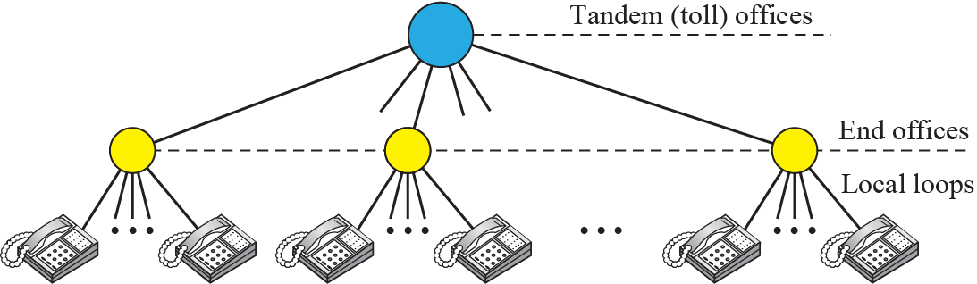
    14.1 Telephone Network
    14.1.2 LATAs
local-access transport areas (LATAs).
Fig. 14.2 Switching offices in a LATA

Slide 5
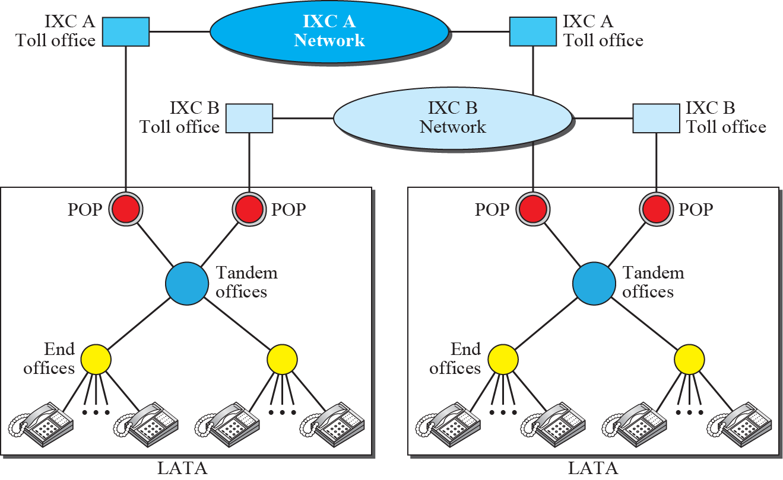
    14.1 Telephone Network
Point of Presence
Fig. 14.2 Points of presence (POPs)

Slide 6
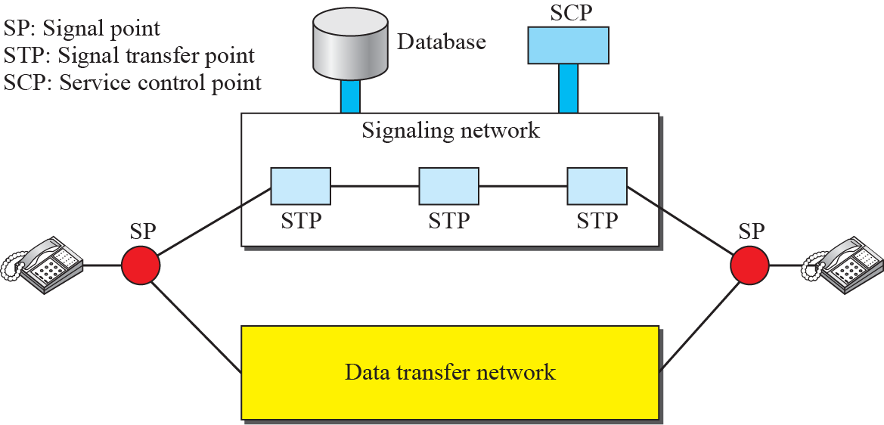
    14.1 Telephone Network
    14.1.3 Signaling
operation to connect the two parties
in-band and out-of-band signaling
Fig. 14. 4 Data transfer and signaling network

Slide 7
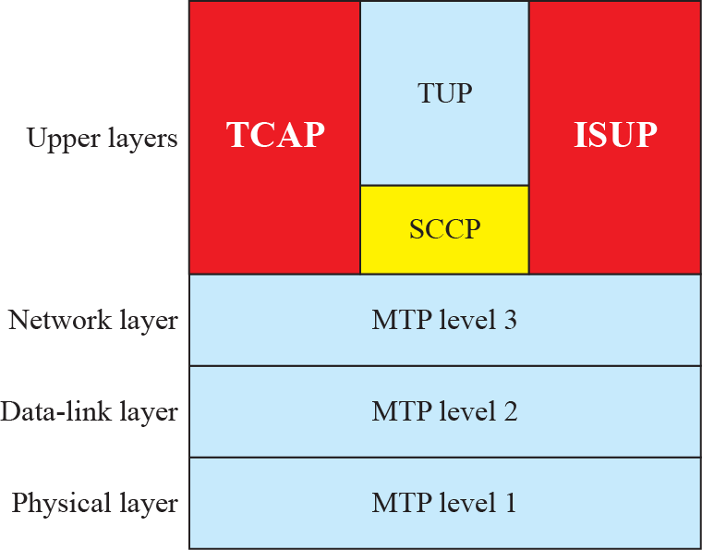
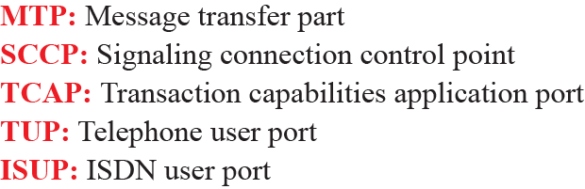
    14.1 Telephone Network
Signaling system seven (SS7)
Fig. 14.5 Layers in SS7

Slide 8
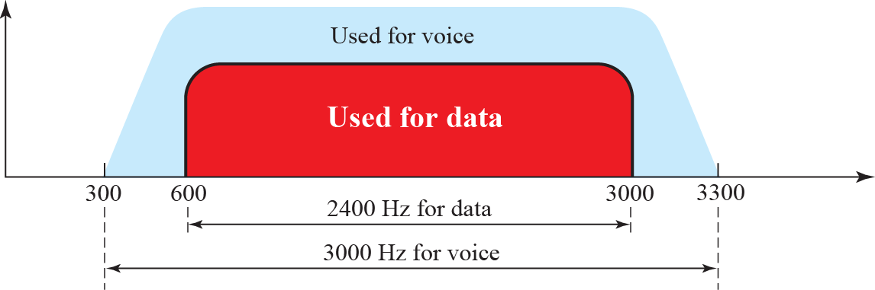
    14.1 Telephone Network
    14.1.4 Services
Analog Services
Digital Services
  Switched/56
  Digital data service (DDS)
    14.1.5 Dial-Up Service
uses a modem
Fig. 14. 6 Telephone line bandwidth

Slide 9
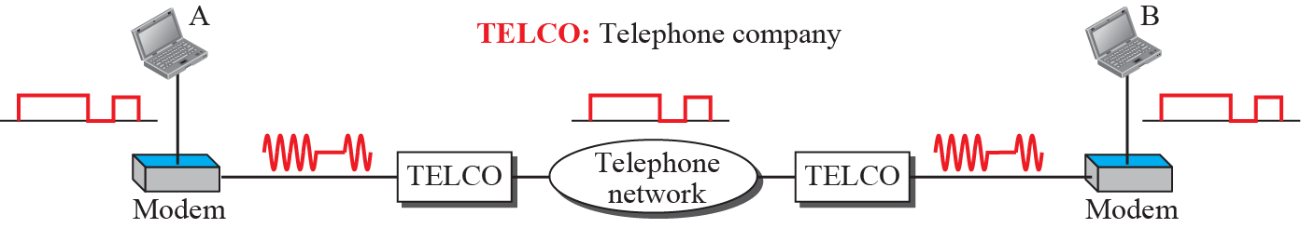
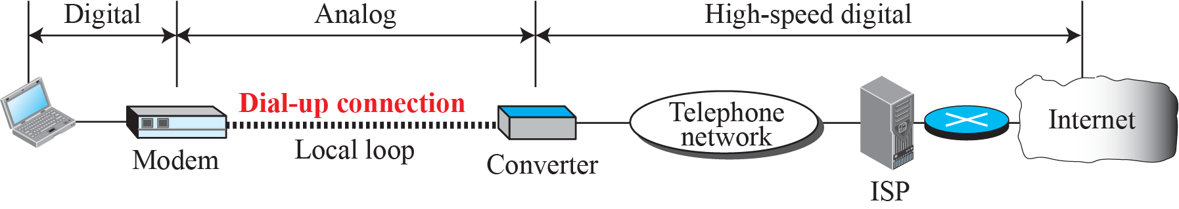
    14.1 Telephone Network
Fig. 14.7 Modulation/demodulation
Fig. 14.8 Dial-up network to provide Internet access

Slide 10
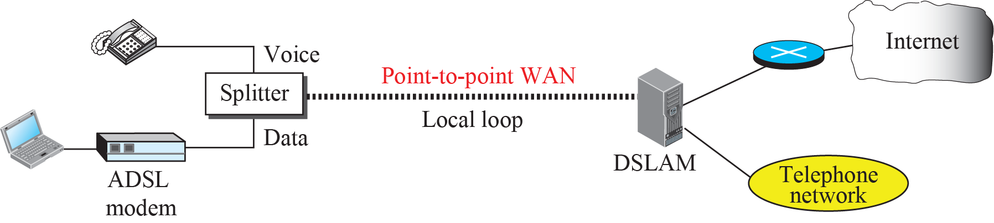
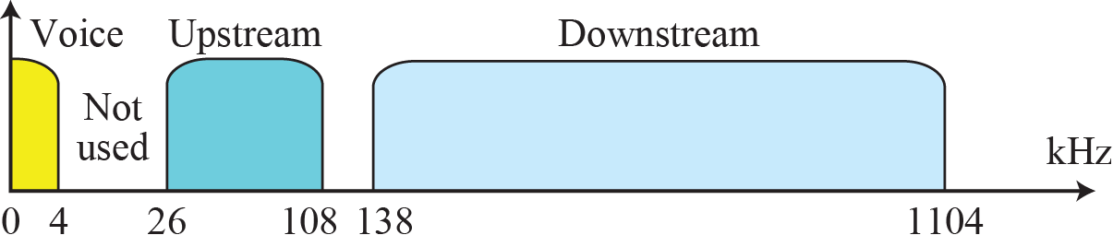
    14.1 Telephone Network
    14.1.5 Digital Subscriber Line (DSL)
to provide higher-speed access to the Internet.
ADSL, VDSL, HDSL, and SDS L (xDSL).
ADSL
  1.1 MHz Bandwidth
  Upload 1.4 Mbps (500 kbps)
  Download 13.4 Mbps (8 Mbps)
Fig. 14. 6 Telephone line bandwidth

Slide 11
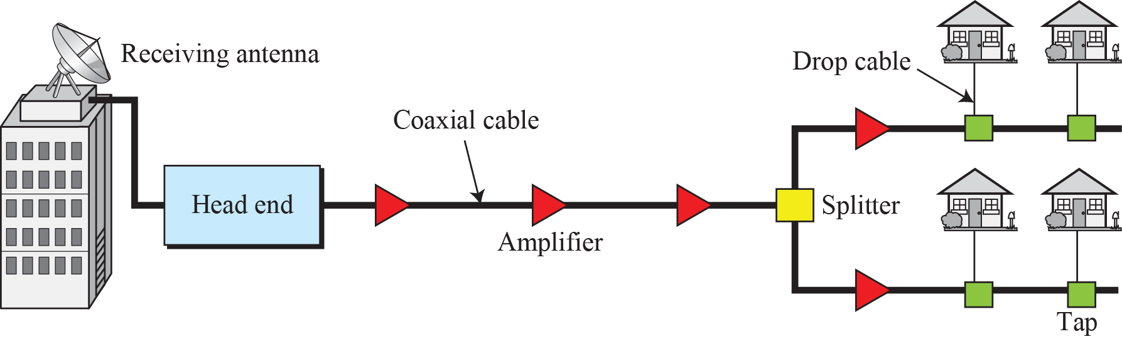
    14.2 Cable Network
    14.2 Cable Network
    14.2.1 Traditional Cable Networks
started to distribute broadcast video signals to locations with poor or no reception in the late 1940s .
was called community antenna television (CATV)
Fig. 14.10 Traditional cable TV network

Slide 12
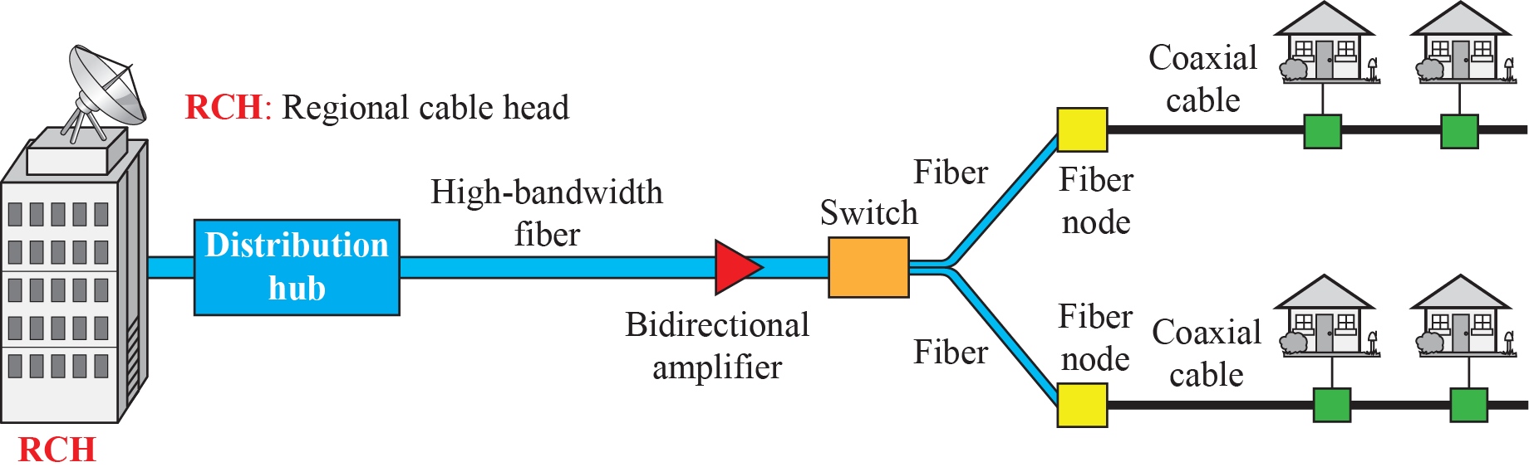
    14.2 Cable Network
    14.2.2 HFC Networks
hybrid fiber-coaxial (HFC) network.
uses a combination of fiber-optic and coaxial cable.
Fig. 14.11 HFC network

Slide 13
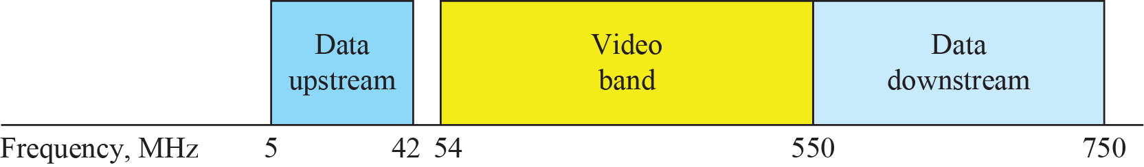
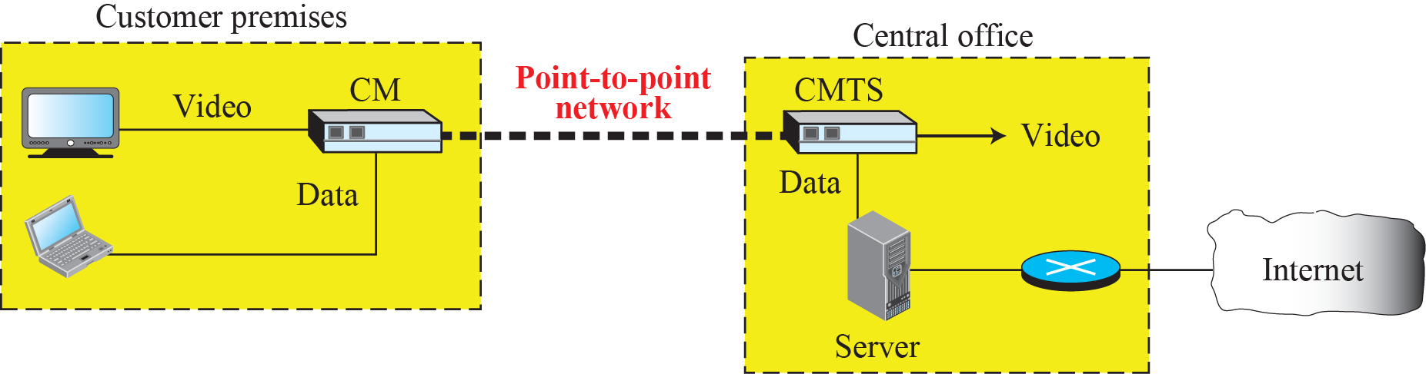
    14.2 Cable Network
    14.2.3 Cable TV for Data Transfer
is competing with DSL(UTP)
is coaxial cable network.
Fig. 14.12 Division of coaxial cable band by CATV
Fig. 14.13 Cable modem transmission system (CMTS)

Slide 14
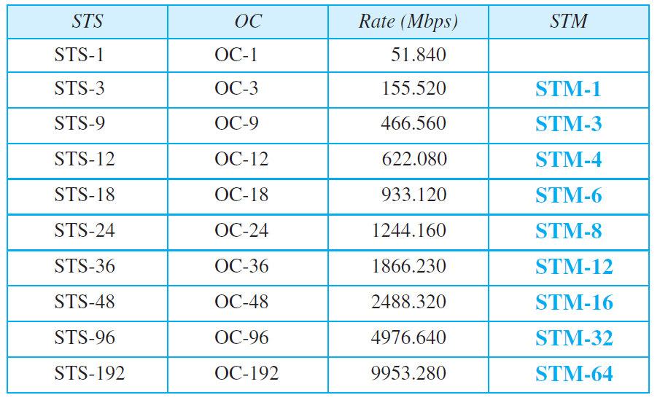
    14.3 SONET
    14.3 SONET
is used in wide area network (WAN)
Synchronous Otical Network(ANSI), Synchronous Digital Hierarchy(ITU-T)
    14.3.1 Architecture
Table 14.1 SONET rates

Slide 15
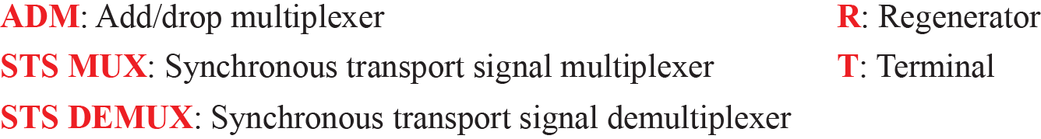
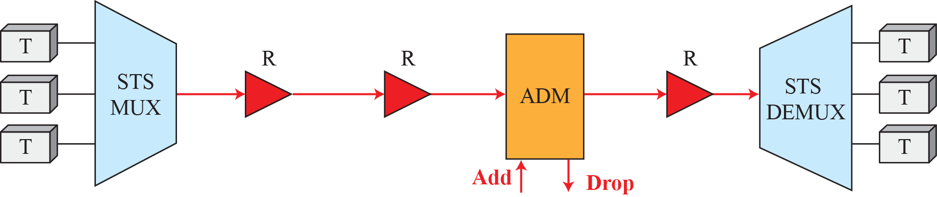
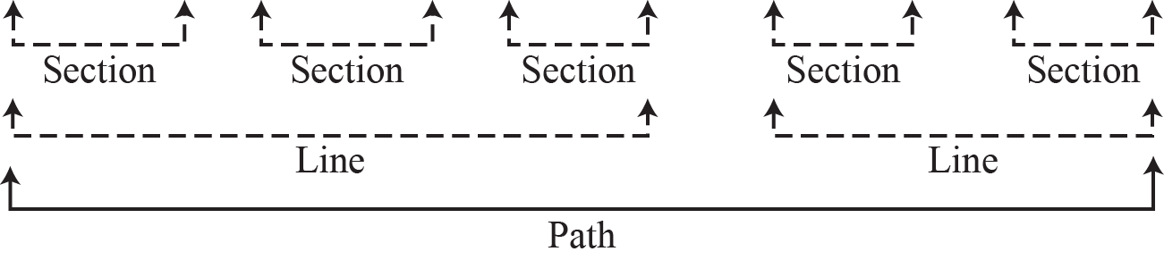
    14.3 SONET
Fig. 14.14 A simple network using SONET equipment

Slide 16
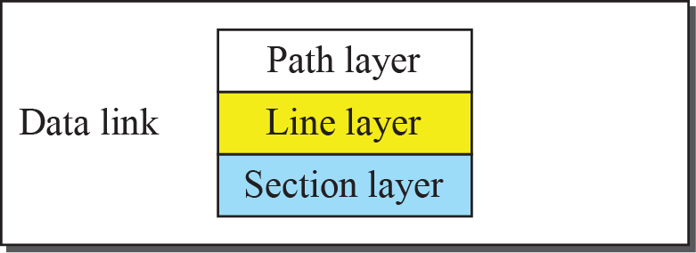
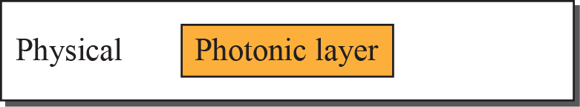
    14.3 SONET
    14.3.2 SONET Layers
Fig. 14.15 SONET layers compared with OSI or the Internet layers

Slide 17
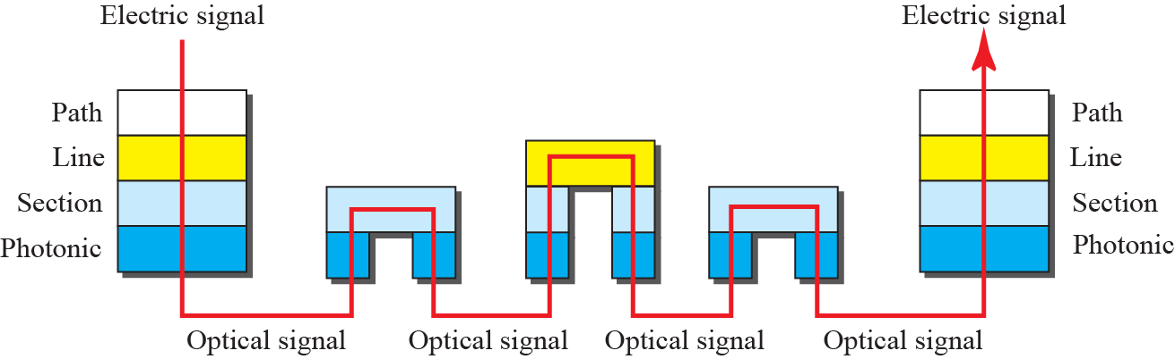
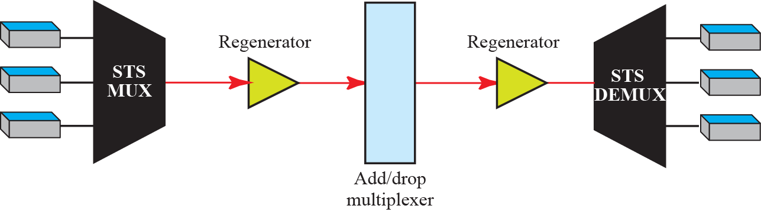
    14.3 SONET
Fig. 14.16 Device-Layer relationship in SONET

Slide 18
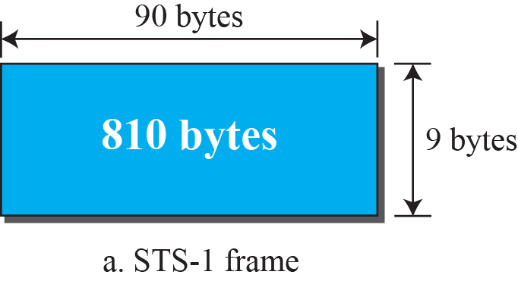
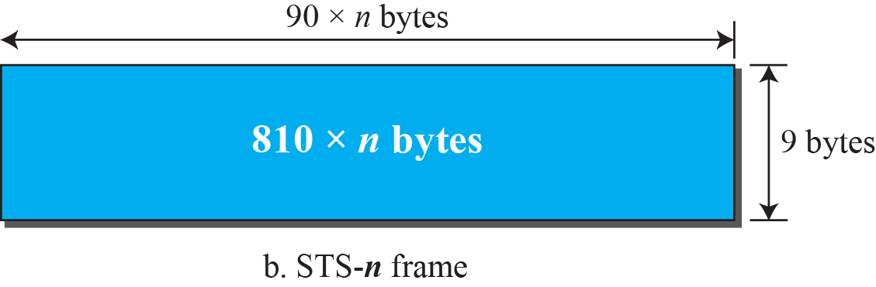
    14.3 SONET
    14.3.3 SONET Frames
Fig. 14.17 STS-1 and STS-n frames

Slide 19
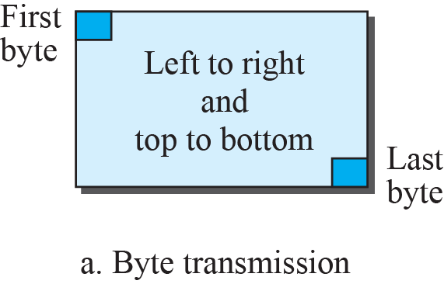
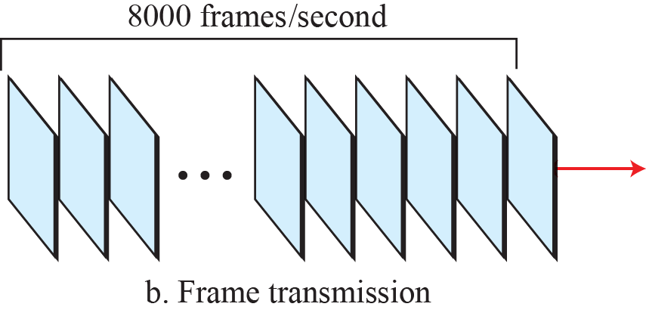
    14.3 SONET
Fig. 14.18 STS frames in transition

Slide 20
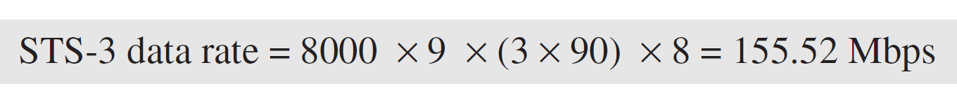
    Homework
Ex. 14.1
Find the data rate of an STS-1 signal.
Ex. 14.2
Find the data rate of an STS-1 signal.
Ex. 14.3
What is the duration of an STS-1 frame? STS-3 frame? STS-n
frame?
In SONET, 8000 frames are sent per second. This means that
the duration of an STS-1, STS-3, or STS-n frame is the same
and equal to 1/8000 s, or 125 μs.

Slide 21
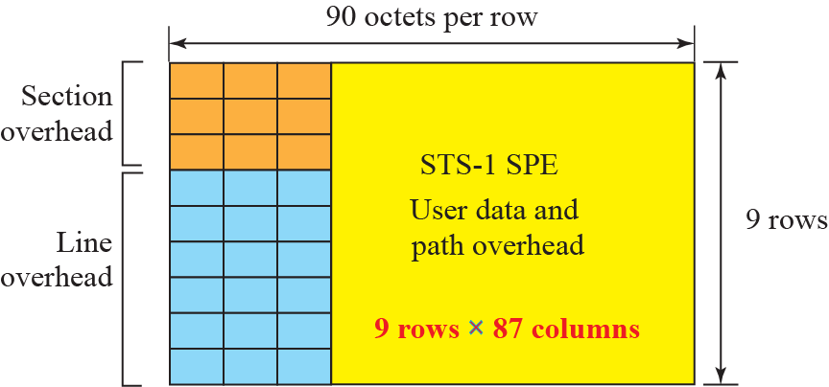
    14.3 SONET
    STS-1 Frame Format
Fig. 14.19 STS-1 frames overheads

Slide 22
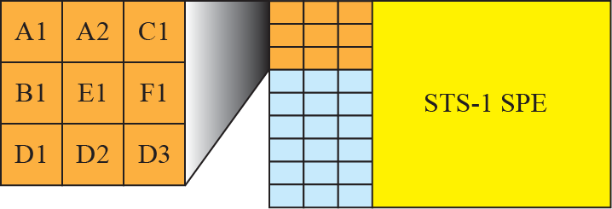
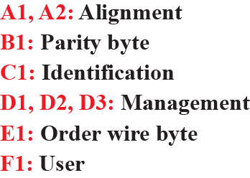
    14.3 SONET
    STS-1 Frame: section overhead
Fig. 14.20 STS-1 frame: section overheads

Slide 23
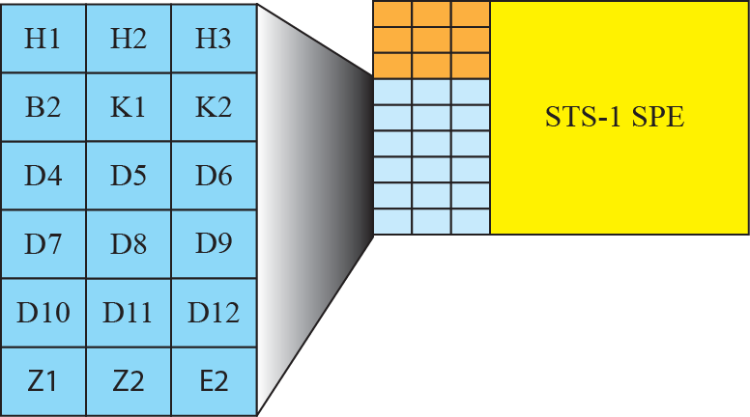
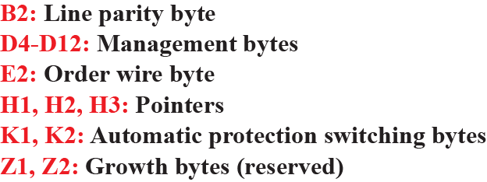
    14.3 SONET
    STS-1 Frame: line overhead
Fig. 14.21 STS-1 frame: line overheads

Slide 24
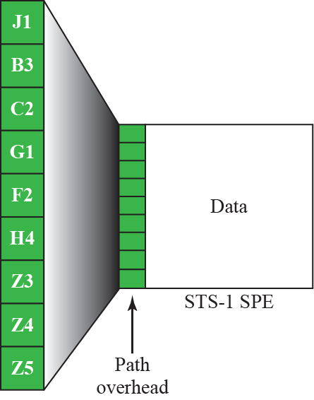
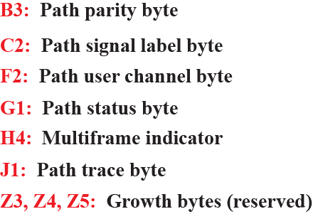
    14.3 SONET
    STS-1 Frame: path overhead
Fig. 14.22 STS-1 frame: path overheads

Slide 25
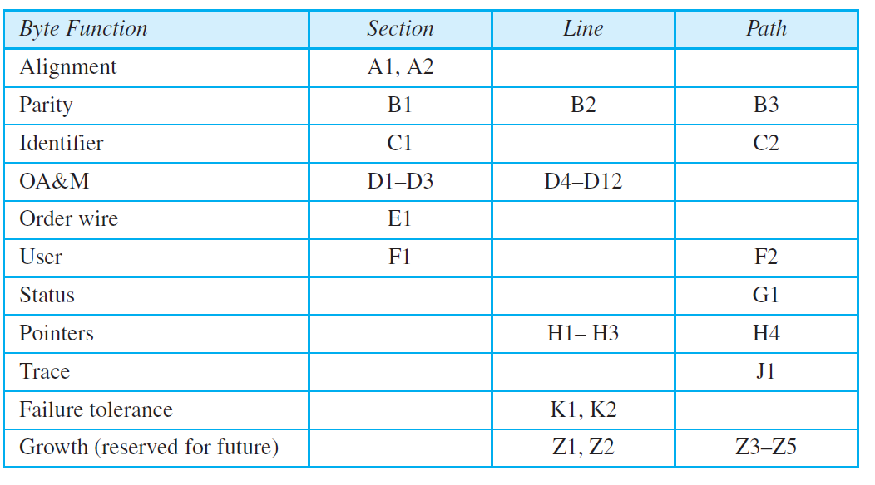
    14.3 SONET
    Overhead summary
Table 14.2 SONETs overhead

Slide 26
    Homework
Ex. 14.4
Find the data rate of an STS-1 signal. (without considering the overheads)?

Slide 27
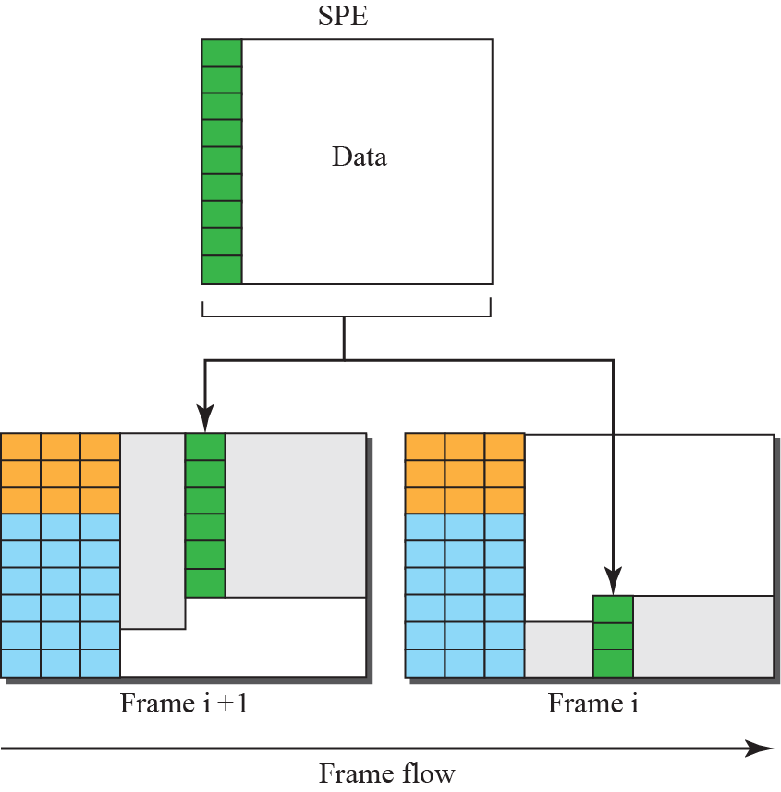
    14.3 SONET
    Encapsulation
Fig. 14.23 Offsetting of SPE related to frame boundary

Slide 28
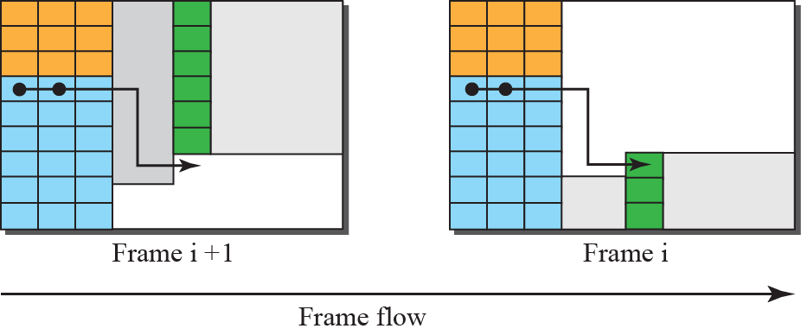
    14.3 SONET
Fig. 14.24 The use of H1 and H2 to show the start of SPE
Ex. 14.5
What are the values of H1 and H2 if an SPE starts at byte number 650?
The number 650 can be expressed in four hexadecimal digits as 0x028A.
This means the value of H1 is 0x02 and the value of H2 is 0x8A.

Slide 29
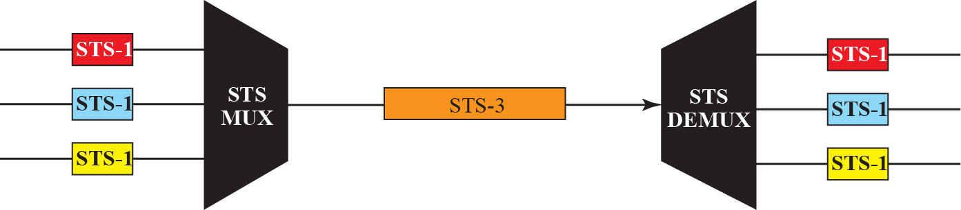
    14.3 SONET
    14.3.4 STS Multiplexing
In SONET, all clocks in the network are locked to a master clock.
Fig. 14.25 STS multiplexing/demultiplesing

Slide 30
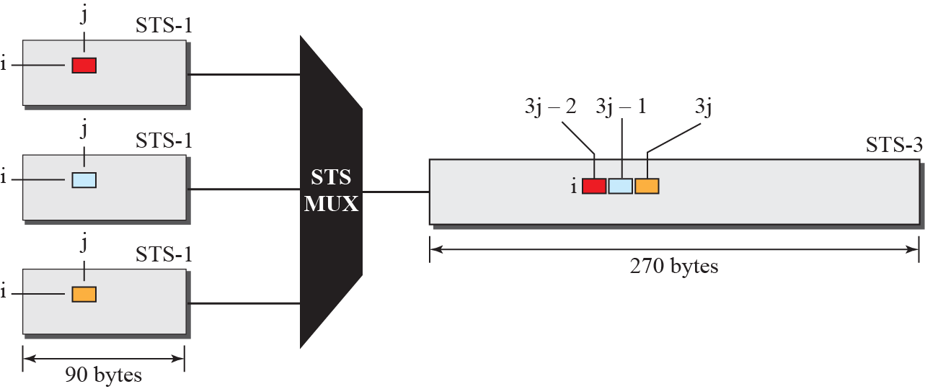
    14.3 SONET
Byte Interleaving
Fig. 14.26 Byte interleaving

Slide 31
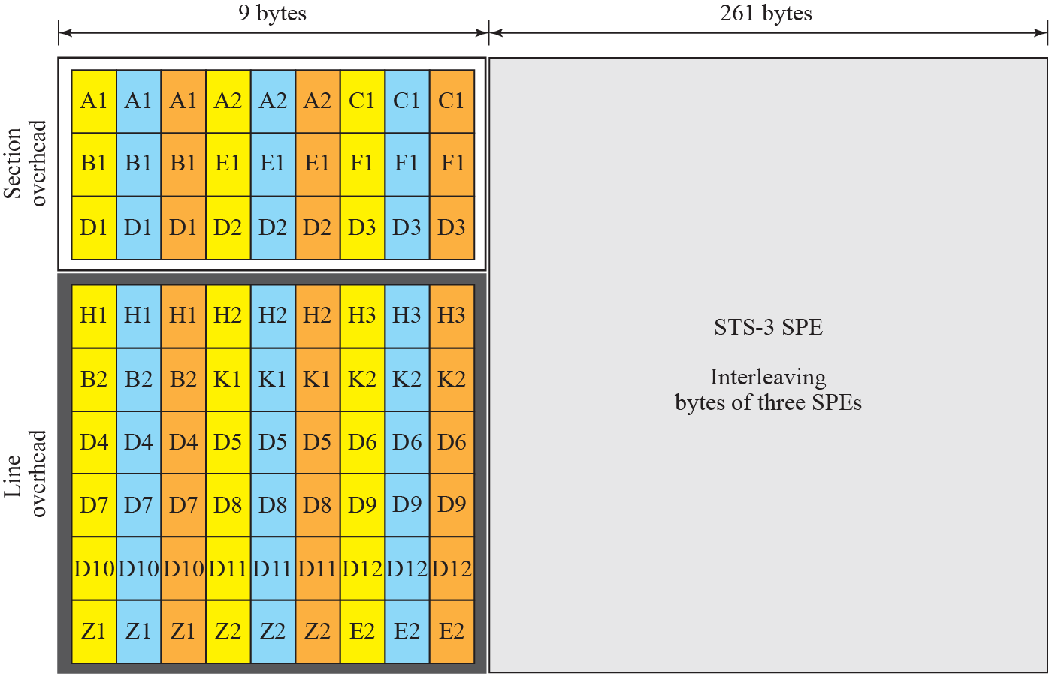
    14.3 SONET
Fig. 14.27 An STS-3 frame

Slide 32
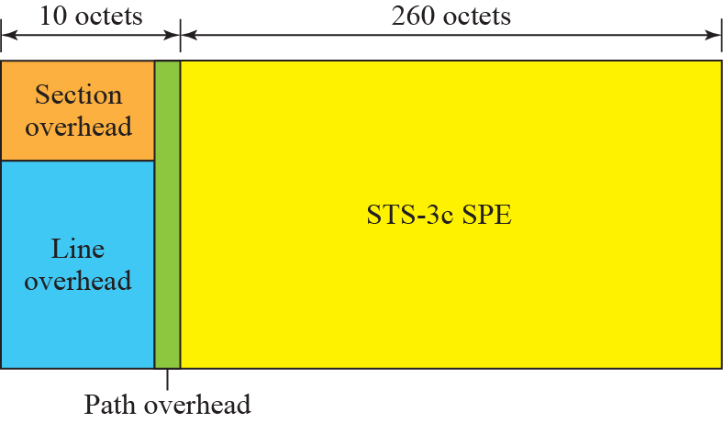
    14.3 SONET
    Concatenated Signal
An STS-3c signal can carry 44 ATM cells as its SPE
Fig. 14.28 A concatenated STS-3c signal

Slide 33
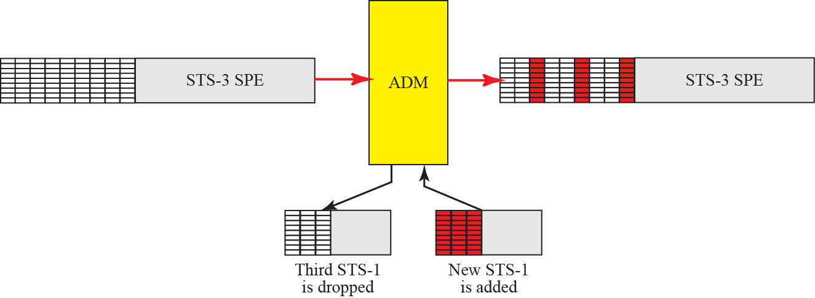
    14.3 SONET
    Add/Drop Multiplexer
Fig. 14.29 Dropping and adding grames in a add/drop multiplexer

Slide 34
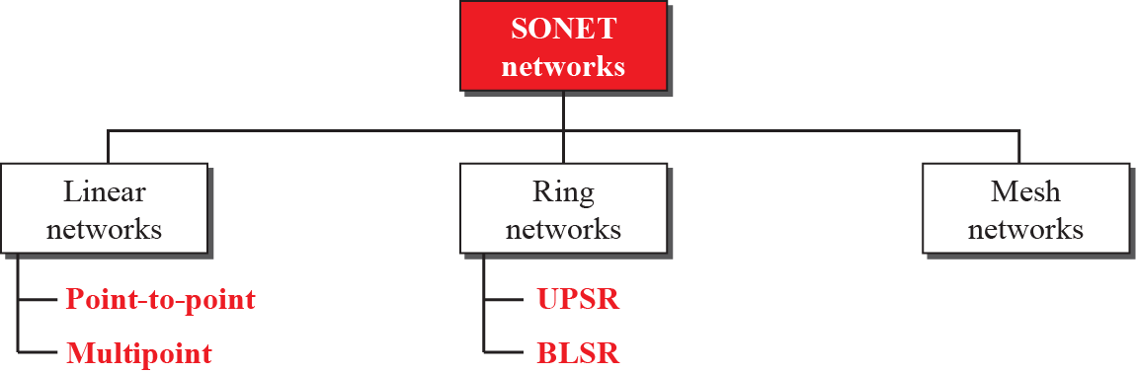
    14.3 SONET
    14.3.5 SONET Networks
can be used as a high-speed backbone carrying loads from other networks
Fig. 14.30 Taxonomy of SONET networks

Slide 35
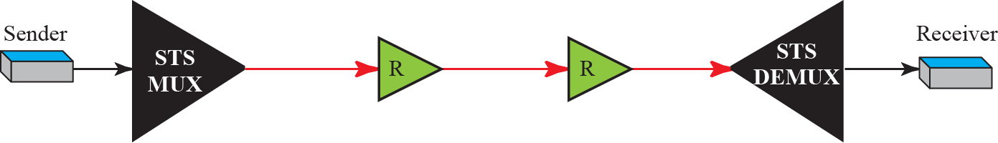
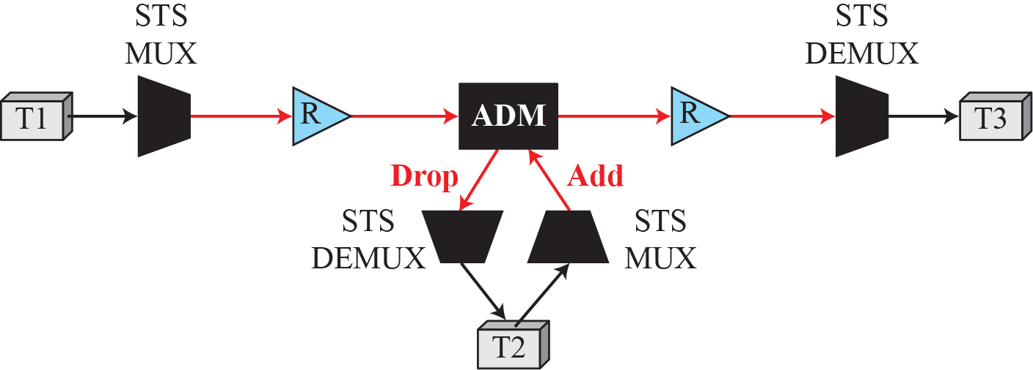
    14.3 SONET
    Linear Networks
Point-to-point networks
Fig. 14.31 A point-to-point SONET network
Multipoint networks
Fig. 14.32 A multipoint SONET network

Slide 36
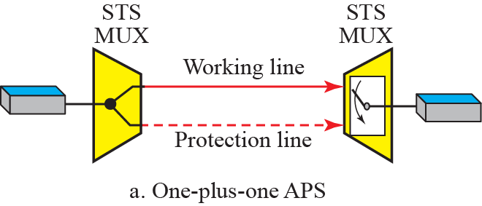
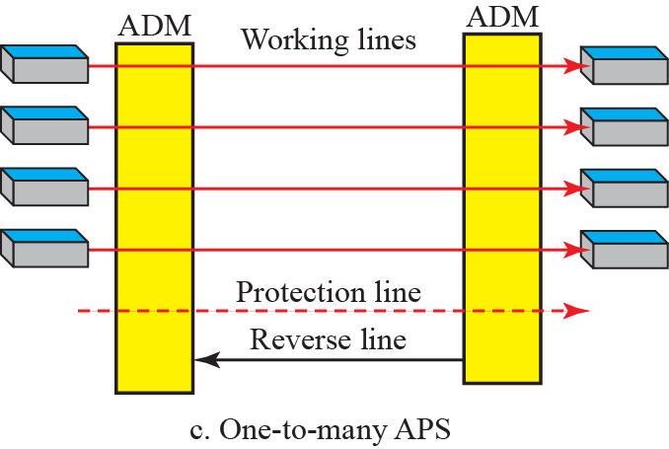
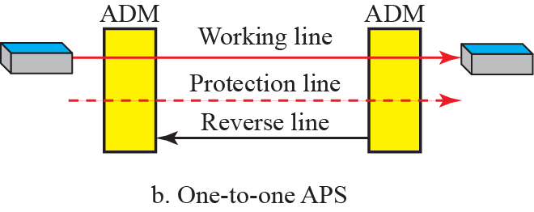
    14.3 SONET
Automatic Protection Switching
Fig. 14.33 Automatic Protection Switching in linear network

Slide 37

    14.3 SONET
    Ring Networks
Unidirectional Path Switching Ring (UPSR)
Fig. 14.34 A Unidirectional Path Switching Ring

Slide 38

    14.3 SONET
Bidirectional Line Switching Ring (BLSR)
Fig. 14.35 A Bidirectional Line Switching Ring

Slide 39

    14.3 SONET
Combination of Ring
Fig. 14.36 A Combination of Ring

Slide 40


    14.3 SONET
    Mesh Networks
Fig. 14.37 A Mesh SONET networks

Slide 41

    14.3 SONET
    14.3.6 Virtual Tributaries
To make SONET backward-compatible with the current hierarchy.
we can subdivide the SPE and call each component a VT.
    Fig. 14.38 Virtual Tributaries

Slide 42


    14.3 SONET
    Types of VTs
    Fig. 14.39 Virtual Tributary types

Slide 43
    14.4 ATM
    14.4 ATM
Asynchronous Transfer Mode
is a switched wid wide area network
is based on the cell relay protocol designed by the ATM forum
is adopted by the ITU-T.
The combination of ATM and SONET will allow high-speed interconnection of all the world’s networks.

Slide 44
    14.4 ATM
    14.4.1 Design Goals
The need for a transmission system to optimize the use of high-data-rate.
The system must interface with existing systems.
The design must be implemented inexpensively.
The new system must be able to work with and support the existing hierarchies
The new system must be connection-oriented.
Last but not least, one objective is to move as many of the functions to hardware as possible.

Slide 45


    14.4 ATM
    14.4.2 Problems
examine some of the problems associated with existing systems.
Fig. 14.40 Multiplexing using different frame size
Fig. 14.41 Multiplexing using cells

Slide 46

    14.4 ATM
Fig. 14.42 ATM multiplexing

Slide 47

    14.4 ATM
    14.4.3 Architecture
UNI (user-to-network interface) : between user device and switches connection
NNI (network-to-network interface) : inter-switches connection
Fig. 14.43 Architecture of an ATM network

Slide 48



    14.4 ATM
Fig. 14.44 TP , VPs, and VCs
Fig. 14.45 Virtual connection identifiers in UNIs and NNIs

Slide 49




    14.4 ATM
Fig. 14.46 An ATM cell
Fig. 14.47 Routing with a switch

Slide 50


    14.4 ATM
Fig. 14.48 ATM layers

Slide 51



    14.4 ATM
Fig. 14.49 AAL5

Slide 52
    Homework
Always Thanks!
Have a Nice Summer Vacation!!

